Slide 1
Think Tanks
Regional Science Academy – Think Tank Task Force
Kingsley Haynes, Co-Chair
September 2016

Slide 2
Think Tank: Defined
Policy institute or research institute or organization that performs research and advocacy concerning topics such as social policy, political strategy, economics, military technology and culture.
May be public or private, interdisciplinary or topic specific.

Slide 3
Early Think Tanks
Royal United Services Institution (1931)
  Also called Royal United Services Institute for Defense and Security Studies
Fabian Society (1884)
  Split in 1884 from Fellowship for New Life
Brookings Institution (1916)
  Formerly the Institute for Government Research (IGR)
Political and Economic Planning (1931)
  Merged with Centre for the Study of Social Policy, to become the Policy Studies Institute in 1978

Slide 4
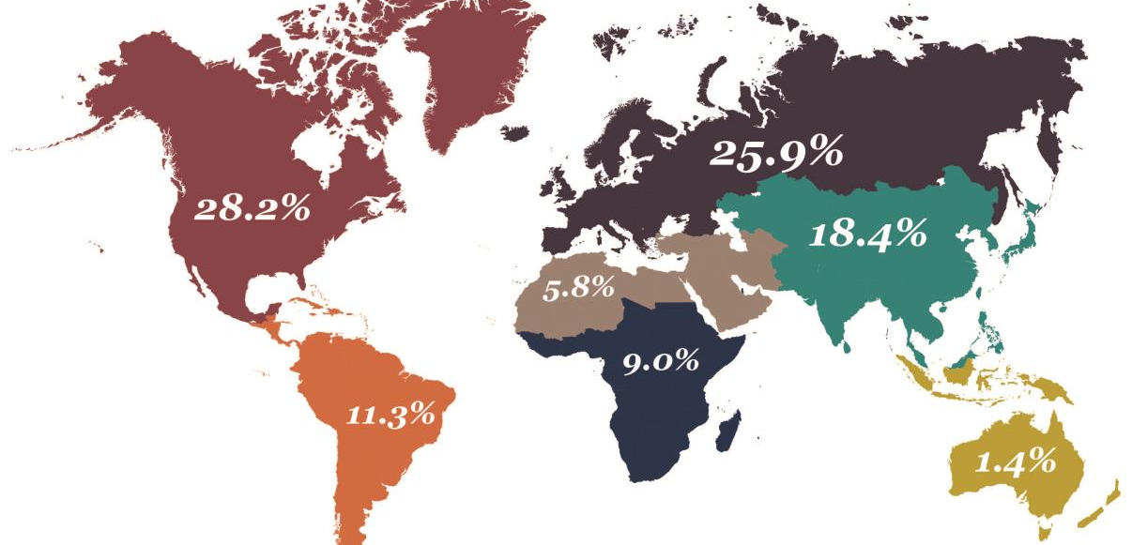
Global Think Tank Total = 6,846
Source: Global Go To Think Tank Index Report – 2015

Slide 5
Lists of Think Tanks #1
http://repository.upenn.edu/think_tanks/10/
The Global Go To Think Tank Index Report (GGTTTI) from the Think Tanks and Civil Society Program (TTCSP) – University of Pennsylvania ranks think tanks worldwide.
Categories used are
  Top Think Tanks in the World
  Top Think Tanks by Region
  Top Think Tanks by Area of Research
  Top Think Tanks by Special Achievement

Slide 6
Lists of Think Tanks #2
http://www.thebestschools.org/features/most-influential-think-tanks
Based on popularity of think tank’s website
  Average yearly revenue
  Average printed media references (impact factor?)
  Number of categories included in Global Go To Think Tank Index
‘It is based on the perceptions of hundreds of journalists, policymakers, and think tank employees.’

Slide 7
Lists of Think Tanks #3
http://www.nira.or.jp/english/nwdtt/nwdtt.html
AKA World Directory of Think Tanks
By National Institute for Research Advancement (NIRA) – a Japanese organization
Provides a searchable database and list by county

Slide 8
Think Tank Tasks
Produce/incubate ideas to lead policy
Collect/supply knowledge
Promote/advocate ideas to sway opinion/policy/course of action
Be intellectually independent for credibility

Slide 9
The Politics of Think Tanks in Europe
Jesper Dalh Kelstrup (2016)
Location and policy content (Craft & Howlette, 2012)
Visibility of think tanks to policy makers (Medvetz, 2012)
Recognition of capitalism knowledge distribution in institutional terms from coordinated to liberal market economies (Campbell & Pederson, 2014)
Qualitative differences in think tanks by visibility variables across Europe, 2006-2012 (Kelstrup, 2015)

Slide 10
The Tanks and Civil Societies
J.G. McGann & R.K. Weaver (2000, 2002, 2005)
Think tank typologies: advocacy, contract research, organization/university w/o students, policy clubs, policy enterprises, idea generators, furthering debate, policy oriented research clusters
Rich (2004) typology elements: independent, non-interest based, non profit, non government, autonomous political agents, independently funded
Alternative perspectives: instrumental vs. national
Role of stakeholders

Slide 11
AN RSA Think Tank Observation
All think tanks appear to have national/regional/local geographic focus and/or subject focus
Multiple think tanks may be doing similar content analysis (urbanization, poverty alleviation, housing, etc.) in different places and fitting their results to national or local settings.
UN/World Bank/International interests about what think tanks do locally and their roles which reflect think tank association at national/international levels

Slide 12
An RSA Think Tank Proposal
FILL THE GAP?
RSA has a content or subject area focus that can be developed and made distinctive (regional disparity, regional response to disaster and hazards, regional environment and sustainability, regional convergence etc.) Taken alone this would not make RSA Think Tank unique.
However, there is no truly internationally integrated think tank working group on regional development issues focusing on lessons learned world wide.

Slide 13
URL: RSAThinkTank.gmu.edu
Purpose:
Provide a location for gathering think tank information for task force discussions
Provide a location for shared comments and recommendations

